Slide 1
Map reduce

Slide 2
Contents
Hadoop Data Types
Hadoop MapReduce paradigm
Map and Reduce tasks
MapReduce Execution Framework
MapReduce Examples

Slide 3
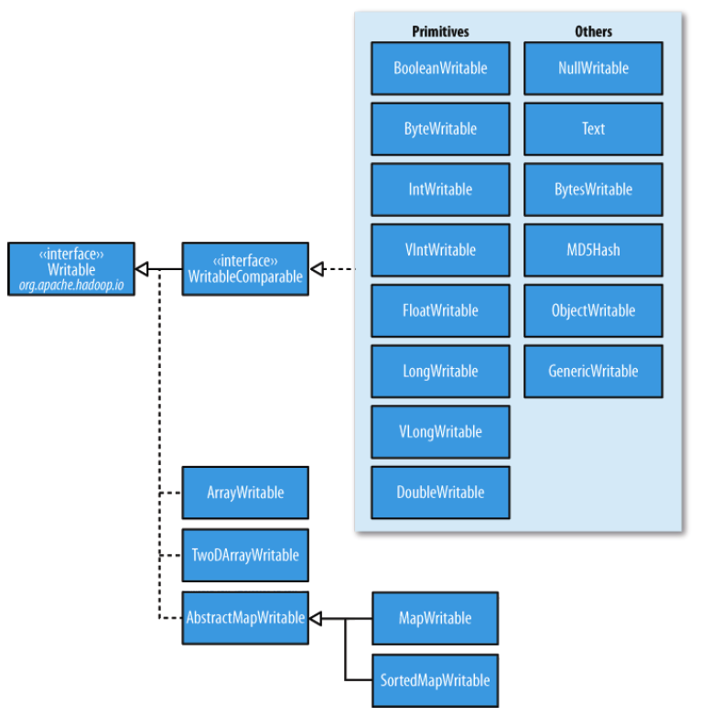
Hadoop Data Types
Hadoop Data Types
Hadoop provides several primitive data types in writable versions.
Int --------> IntWritable
Long ------> LongWritable
Boolean--> BooleanWritable
Float ------> FloatWritable
byte ------> ByteWritable

Slide 4
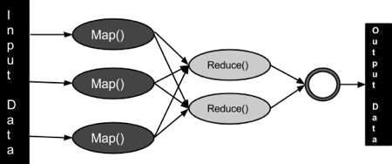
Hadoop MapReduce paradigm
Main Class :-
A main class contains a run method and a main method.All required libraries are available in the Hadoop packages. The main class in mapreduce also called Driver class is the main configuration class.
Job submission is the starting point in the life of a MapReduce job.
All configuration details should be in run method.
Mapper class.
Reducer class.
InputFormat class for Mapper.
OutputFormat class for Reducer.
Input key-value Data type.
Output key-value Data type.
Job Name.
Jar class.
An object of configuration class.
An object of Job class to set all configuration on run method.
Main method contains ToolRunner object to run the job.

Slide 5
Hadoop MapReduce paradigm
Mapper Class:-
A MapReduce job exists to read input data splits through a number of map tasks. The Job object created the information about all the splits and wrote a file with the split information and many other job related info so that the JobTracker has access to that file. The JobTracker is actually responsible for starting the tasks for the submitted job.
InputFormat describes the input-specification for a MapReduce job. The default one is TextInputFormat that breaks files into lines. Keys are the position in the file, and values are the line of text.InputSplit represents the data to be processed by an individual Mapper. FileSplit is the default InputSplit.
OutputFormat describes the output-specification for a MapReduce job. The MapReduce framework relies on the OutputFormat of the job to. TextOutputFormat is the default OutputFormat.
A mapper class contains a map method where the main input data is processed by mapper ,each key is processed and a value for each key is provided.
A mapper class contains 4 arguments first two datatypes are for InputData provided from RecordReader(InputFormat) as key-value and other two datatypes are processed output from mapper a key-value pair and this output is given to reducer as input for reducer. A mapper processed data per line given by InputFormat.
If we customize combiner and partitioner class these will also run before reduce phase.

Slide 6
Hadoop MapReduce paradigm
Reducer Class:-
Reduce(intermediateKey, list(intermediateValue)) -> list(outKey, outValue).Each reduce function processes the intermediate values for a particular key generated by the map function and generates the output. Essentially there exists a one-one mapping between keys and reducers. Several reducers can run in parallel, since they are independent of one another. The number of reducers is decided by the user. By default, the number of reducers is 1.
When all the map outputs have been copied, the reduce task moves into the merge phase which merges the map outputs, maintaining their sort ordering. This is done in rounds.
During the reduce phase, the reduce function is invoked for each key in the sorted output. The output of this phase is written directly to the output filesystem, typically HDFS. In the case of HDFS, since the TaskTracker node is also running a DataNode, the first block replica will be written to the local disk.
The input data provided to reducer contains a list of values per key , so we needs a Iterable function to iterate the list of values (key per values).
A Reducer class also contains 4 arguments first two is the input to reducer provided by mapper and other two arguments are Output of the job written to HDFS.
Combiner Class:-
The combiner class is used as an optimization for the MapReduce job. The combiner function runs on the output of the map phase and is used as a filtering or an aggregating step to lessen the number of intermediate keys that are being passed to the reducer. In most of the cases the reducer class is set to be the combiner class. The difference lies in the output from these classes. The output of the combiner class is the intermediate data that is passed to the reducer whereas the output of the reducer is passed to the output file on disk.

Slide 7
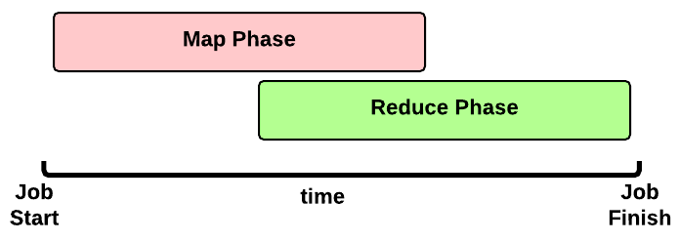
Map and Reduce tasks
Timeline of a MapReduce Job
This is the timeline of a MapReduce Job execution:-
Map Phase: several Map Tasks are executed
Reduce Phase: several Reduce Tasks are executed
Note:- That the Reduce Phase may start before the end of Map Phase. Hence, an interleaving between them is possible.

Slide 8
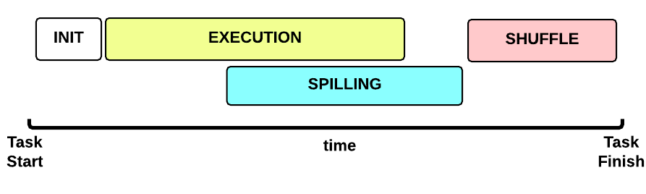
Map Phase
This is the Map Task execution timeline:
INIT phase: we setup the Map Task
EXECUTION phase: for each (key, value) tuple inside the map split we run the map() function
SPILLING phase: the map output is stored in an in-memory buffer; when this buffer is almost full then we start (in parallel) the spilling phase in order to remove data from it
SHUFFLE phase: at the end of the spilling phase, we merge all the map outputs and package them for the reduce phase

Slide 9
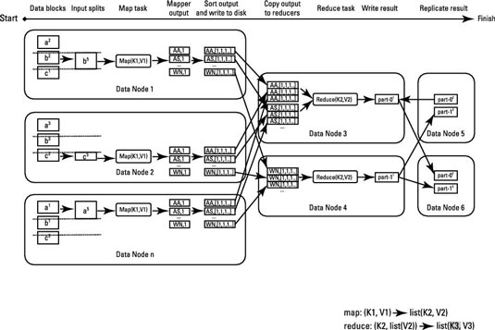
Reduce Phase
The reducer takes the grouped data as input and runs a reduce function once per key grouping. The function is passed the key and an iterator over all of the values associated with that key. A wide range of processing can happen in this function, as we’ll see in many of our patterns. The data can be aggregated, filtered, and com‐bined in a number of ways. Once the reduce function is done, it sends zero or more key/value pair to the final step, the output format. Like the map function, the reduce function will change from job to job since it is a core piece of logic in the solution.

Slide 10
MapReduce Example: Word Count
Count the number of occurrences of each word in a large amount
of input data
Map(input_key, input_value) foreach word w in input_value:
emit(w, 1)
Input to the Mapper
  (3414, 'the cat sat on the mat')
  (3437, 'the aardvark sat on the sofa')
Output from the Mapper
('the', 1), ('cat', 1), ('sat', 1), ('on', 1),
('the', 1), ('mat', 1), ('the', 1), ('aardvark', 1),
('sat', 1), ('on', 1), ('the', 1), ('sofa', 1)

Slide 11
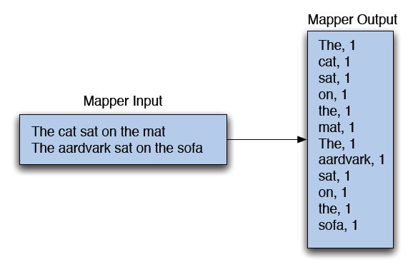
Map Phase

Slide 12
MapReduce: The Reducer
After the Map phase is over, all the intermediate values for a given intermediate key are combined together into a list
This list is given to a Reducer
– There may be a single Reducer, or multiple Reducers
– All values associated with a particular intermediate key are guaranteed to go to the same Reducer
– The intermediate keys, and their value lists, are passed to the Reducer in sorted key order
– This step is known as the ‘shuffle and sort’
The Reducer outputs zero or more final key/value pairs
– These are written to HDFS
– In practice, the Reducer usually emits a single key/value pair for each input key

Slide 13
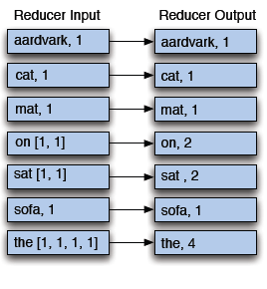
Example Reducer: Sum Reducer
Add up all the values associated with each intermediate key:
reduce(output_key, intermediate_vals)
set count = 0
foreach v in intermediate_vals:
count += v
emit(output_key, count)
Reducer output:
('aardvark', 1)
('cat', 1)
('mat', 1)
('on', 2)
('sat', 2)
('sofa', 1)
('the', 4)

Slide 14
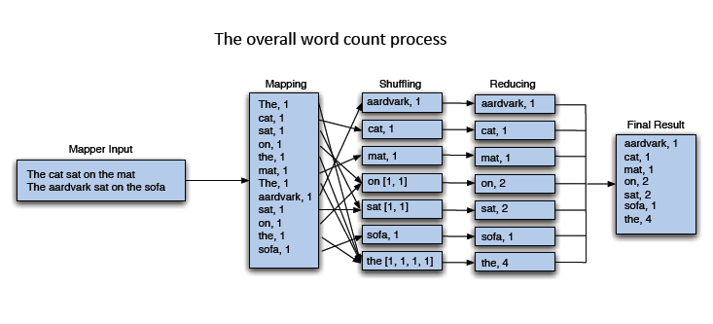
Putting It All Together

Slide 15
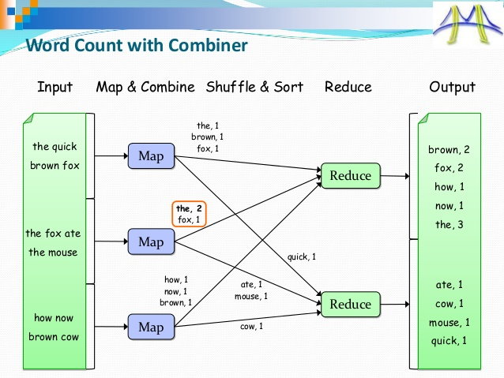

Slide 16
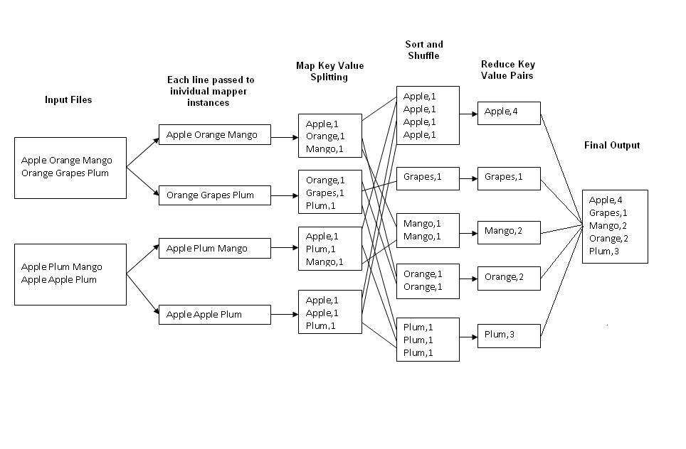

Slide 17
The goal of the Mapper is to produce a partitioned file sorted by the Mapper output keys. The partitioning is with respect to the reducers the keys are meant to be processed by. After the Mapper emits its key and value pair, they are fed to a Partitioner instance that runs in the same JVM as the Mapper. The Partitioner partitions the Mapper output, based on the number of Reducers and any custom partitioning logic.
At this point, the Combiner is invoked (if a Combiner is configured for the job) . Note that the Combiner is invoked after the Partitioner in the same JVM as the Mapper.
Finally this partitioned, sorted and combined output is spilled to the disk. Optionally the Mapper intermediate outputs can be compressed.

Slide 18
The three main sub phases in the Reduce phase are-
Shuffle
Merge/Sort
Invocation of the reduce() method.
The Shuffle phase ensures that the partitions reach the appropriate Reducers. The Shuffle phase is a component of the Reduce phase. During the Shuffle phase, each Reducer uses the HTTP protocol to retrieve its own partition from the Mapper nodes.
As each Mapper instance completes, it notifies the Application Master about the partitions it produced during its run. Each Reducer periodically queries the Application Master for Mapper hosts until it has received a final list of nodes hosting its partitions.

Slide 19
The number of maps is usually driven by the number of DFS blocks in the input files. Although that causes people to adjust their DFS block size to adjust the number of maps
The default InputFormat behavior is to split the total number of bytes into the right number of fragments. However, in the default case the DFS block size of the input files is treated as an upper bound for input splits. A lower bound on the split size can be set via mapred.min.split.size. Thus, if you expect 10TB of input data and have 128MB DFS blocks, you'll end up with 82k maps. Ultimately the InputFormat determines the number of maps.
The default number of mappers and reducer can also be changed by the user.
Number of mappers and reducers can be set during command line execution of jar or in the code.

Slide 20
In the code,one can configure JobConf variable to set number of mappers and reducers. Lets say we have JobConf variable as job.
job.setNumMapTasks(5); // 5 mappers
job.setNumReduceTasks(2); // 2 reducers
If a combiner is used after mapper,it lessens the number of keys arriving at the reducer as it works at the mapper side itself to combine the similar keys on that particular mapper,hence decreasing the load on
reducer
Users can optionally specify a combiner in the code, via Job.setCombinerClass(Class) , to perform local aggregation of the intermediate outputs, which helps to cut down the amount of data transferred from the Mapper to the Reducer
The fewer keys each reducer has to work with, the faster the overall job will be ... so long as you have the available reducer resources in the cluster, of course.

Slide 21
OutputCollector<K,V>
Collects the <key, value> pairs output by Mappers and Reducers.
OutputCollector is the generalization of the facility provided by the Map-Reduce framework to collect data output by either the Mapper or the Reducer i.e. intermediate outputs or the output of the job.
The output from the Map function is stored in Temporary Intermediate Files. These files are handled transparently by Hadoop, so in a normal scenario, the programmer doesn't have access to that
Use output.collect(key,value) pair when using ouput collector for output to send over the intermediate values
Context write method is also used to write the output and in Output collect method is used to put the output
The difference is between old and new api
New Api
use "context" object to communicate with mapReduce system
Old Api
JobCon , the OutputCollecto and the Reporter object used for communicate with Map reduce System

Slide 22
A facility for Map-Reduce applications to report progress and update counters, status information etc.
Mapper and Reducer can use the Reporter provided to report progress or just indicate that they
are alive. In scenarios where the application takes significant amount of time to process individual
key/value pairs, this is crucial since the framework might assume that the task has timed-out
and kill that task.
InputFormat describes the input-specification for a Map-Reduce job.
The Map-Reduce framework relies on the InputFormat of the job to:
Validate the input-specification of the job.
2.Provide the RecordReader implementation to be used to glean input records from the logical InputSplit for processing by the Mapper.
setInputFormatClass
setOutputFormatClass
OutputFormat describes the output-specification for a Map-Reduce job.
The Map-Reduce framework relies on the OutputFormat of the job to:
Validate the output-specification of the job. For e.g. check that the output directory doesn't already exist.
Provide the RecordWriter implementation to be used to write out the output files of the job. Output files are stored in a FileSystem.

Slide 23
Identity mapper and reducer
Identity mapper is the default mapper class provided by the hadoop and will be picked up automatically when no mapper class is specified in mapreduce driver class.identity mapper class implements the identity function which directly writes all its input key/value pairs into outputs.
Identity reducer is the default reducer class provided by the hadoop and will be picked up automatically when no reducer class is specified in mapreduce driver class.identity reducer class implements the identity function which directly writes all its input key/value pairs into outputs.
If MapReduce programmer do not set the Mapper Class using JobConf.setMapperClass then IdentityMapper.class is used as a default value same is with identity reducer.
identity mappers and reducers doesn\'t have a body, it only generates key-value pairs. and the package is org.apache.hadoop.mapred. identitymapper / identity reducer.
In case of wordcount exampleif you have Identity reducer, you will have one file output as follows (No aggregating is done). Only Sorting and shuffling happen when you implement the identiy reducer

Slide 24
Open WordCount.java and paste the following code.
import org.apache.hadoop.fs.Path;
import org.apache.hadoop.conf.*;
import org.apache.hadoop.io.*;
import org.apache.hadoop.mapred.*;
import org.apache.hadoop.util.*;
public class WordCount extends Configured implements Tool{ public int run(String[] args) throws Exception
{
//creating a JobConf object and assigning a job name for identification purposes
JobConf conf = new JobConf(getConf(), WordCount.class);
conf.setJobName("WordCount");
//Setting configuration object with the Data Type of output Key and Value conf.setOutputKeyClass(Text.class);
conf.setOutputValueClass(IntWritable.class);
//Providing the mapper and reducer class names
conf.setMapperClass(WordCountMapper.class);
conf.setReducerClass(WordCountReducer.class);
//We wil give 2 arguments at the run time, one in input path and other is output path
Path inp = new Path(args[0]);
Path out = new Path(args[1]);
//the hdfs input and output directory to be fetched from the command line FileInputFormat.addInputPath(conf, inp);
FileOutputFormat.setOutputPath(conf, out);
JobClient.runJob(conf);
return 0;
}
public static void main(String[] args) throws Exception

Slide 25
public static void main(String[] args) throws Exception
{
// this main function will call run method defined above.
int res = ToolRunner.run(new Configuration(), new WordCount(),args);
System.exit(res);
}
}

Slide 26
Open WordCountMapper.java and paste the following code.
import java.io.IOException;
import java.util.StringTokenizer;
import org.apache.hadoop.io.*;
import org.apache.hadoop.mapred.*;
public class WordCountMapper extends MapReduceBase implements Mapper<LongWritable, Text, Text, IntWritable>
{
//hadoop supported data types
private final static IntWritable one = new IntWritable(1);
private Text word = new Text();
//map method that performs the tokenizer job and framing the initial key value pairs
// after all lines are converted into key-value pairs, reducer is called.
public void map(LongWritable key, Text value, OutputCollector<Text, IntWritable> output, Reporter reporter) throws IOException
{
//taking one line at a time from input file and tokenizing the same
String line = value.toString();
StringTokenizer tokenizer = new StringTokenizer(line);
//iterating through all the words available in that line and forming the key value pair
while (tokenizer.hasMoreTokens())
{
word.set(tokenizer.nextToken());
//sending to output collector which inturn passes the same to reducer
output.collect(word, one);
} } }

Slide 27
Open WordCountReducer.java and paste the following code.
import java.io.IOException;
import java.util.Iterator;
import org.apache.hadoop.io.*;
import org.apache.hadoop.mapred.*;
public class WordCountReducer extends MapReduceBase implements Reducer<Text, IntWritable, Text, IntWritable>
{
//reduce method accepts the Key Value pairs from mappers, do the aggregation based on keys and produce the final out put
public void reduce(Text key, Iterator<IntWritable> values, OutputCollector<Text, IntWritable> output, Reporter reporter) throws IOException
{
int sum = 0;
/*iterates through all the values available with a key and add them together and give the final result as the key and sum of its values*/
while (values.hasNext())
{
sum += values.next().get();
}
output.collect(key, new IntWritable(sum));
}
}

Slide 28
//driver class
create a class VoteCountApplication and paste the code below::::::::
package xyz;
import org.apache.hadoop.conf.Configuration;
import org.apache.hadoop.conf.Configured;
import org.apache.hadoop.fs.Path;
import org.apache.hadoop.io.IntWritable;
import org.apache.hadoop.io.Text;
import org.apache.hadoop.mapreduce.Job;
import org.apache.hadoop.mapreduce.lib.input.FileInputFormat;
import org.apache.hadoop.mapreduce.lib.input.TextInputFormat;
import org.apache.hadoop.mapreduce.lib.output.FileOutputFormat;
import org.apache.hadoop.mapreduce.lib.output.TextOutputFormat;
import org.apache.hadoop.util.Tool;
import org.apache.hadoop.util.ToolRunner;
public class VoteCountApplication extends Configured implements Tool
{
public static void main(String[] args) throws Exception
{
int res = ToolRunner.run(new Configuration(), new VoteCountApplication(), args);
System.exit(res);
}

Slide 29
@Override
public int run(String[] args) throws Exception
{
if (args.length != 2)
{
System.out.println("usage: [input] [output]");
System.exit(-1);
}
Job job = Job.getInstance(new Configuration());
job.setOutputKeyClass(Text.class); //output key of reducer
job.setOutputValueClass(IntWritable.class); job.setMapperClass(VoteCountMapper.class); job.setReducerClass(VoteCountReducer.class); job.setInputFormatClass(TextInputFormat.class); //input format of mapper
job.setOutputFormatClass(TextOutputFormat.class); FileInputFormat.setInputPaths(job, new Path(args[0])); FileOutputFormat.setOutputPath(job, new Path(args[1])); job.setJarByClass(VoteCountApplication.class);
job.submit();
return 0;
}
}

Slide 30
//mapper class
create a class VoteCountMapper and paste the code below::
import java.io.IOException;
import org.apache.hadoop.io.IntWritable;
import org.apache.hadoop.io.Text;import org.apache.hadoop.mapreduce.Mapper;
public class VoteCountMapper extends Mapper<Object, Text, Text, IntWritable>
{
private final static IntWritable one = new IntWritable(1);
@Override
public void map(Object key, Text value, Context output) throws IOException,InterruptedException
{
//If more than one word is present, split using white space.
String[] words = value.toString().split(" ");
//Only the first word is the candidate name
output.write(new Text(words[0]), one);
}
}

Slide 31
// reducer
create a class VoteCountReducer and paste the code below::::::::
package xyz;
import java.io.IOException;
import java.util.Iterator;
import org.apache.hadoop.io.IntWritable;
import org.apache.hadoop.io.Text;import org.apache.hadoop.mapreduce.Reducer;
public class VoteCountReducer extends Reducer<Text, IntWritable, Text, IntWritable>
{
@Override
public void reduce(Text key, Iterable<IntWritable> values, Context output) throws IOException, InterruptedException
{
int voteCount = 0;
for(IntWritable value: values)
{
voteCount+= value.get();
}

Slide 32
output.write(key, new IntWritable(voteCount));
}
}
IOException is a class of Exception that was raised due to all Input/Output contingencies .
The file operations like read(), write() and close() etc. are OS dependent and are declared as native methods. In the communication, the OS may not read properly or write properly and also close properly. Even though these failures are very rare, the designers of Java did not take a chance (to make Java a robust language) and informs the programmer through IOException.
 | JobConf and everything else in the org.apache.hadoop.mapred package is part of the old API used to write hadoop jobs, Job and everything in the org.apache.hadoop.mapreduce package is part of the new and preferred API to write hadoop jobs. Both APIs generally provide equivalent core functionality. If you're new to hadoop just start using the new API (i.e. Job and Configuration instead of JobConf).

Slide 33
Package | new API is in the org.apache.hadoop.mapreduce package | old API can still be found in org.apache.hadoop.mapred.
User Code to commnicate with MapReduce Syaterm | use “context” object to communicate with mapReduce system | JobConf, the OutputCollector, and the Reporter object use for communicate with Map reduce System
JOB control | Job control is done through the JOB class in New API | Job Control was done through JobClient (not exists in the new API)
Job Configuration | Job is used for job Configuration through Configuration class . | jobconf objet was use for Job configuration.which is extension of Configuration class. java.lang.Object extended by org.apache.hadoop.conf.Configuration extended by org.apache.hadoop.mapred.JobConf
OutPut file Name | In the new API map outputs are named part-m-nnnnn, and reduce outputs are named part-r-nnnnn (where nnnnn is an integer designating the part number, starting from zero). | in the old API both map and reduce outputs are named part-nnnnn
Diffrence | New API | OLD API
Mapper & Reducer |  | IN OLD API used Mapper & Reduceer as Interface (still exist in New API as well)
Package | new API is in the org.apache.hadoop.mapreduce package | old API can still be found in org.apache.hadoop.mapred.
User Code to commnicate with MapReduce Syaterm | use “context” object to communicate with mapReduce system | JobConf, the OutputCollector, and the Reporter object use for communicate with Map reduce System
Control Mapper and Reducer execution | new API allows both mappers and reducers to control the execution flow by overriding the run() method. | Controlling mappers by writing a MapRunnable, but no equivalent exists for reducers.
JOB control | Job control is done through the JOB class in New API | Job Control was done through JobClient (not exists in the new API)
Job Configuration | Job Configuration done through Configuration class via some of the helper methods on Job. | jobconf objet was use for Job configuration.which is extension of Configuration class. java.lang.Object extended by org.apache.hadoop.conf.Configuration extended by org.apache.hadoop.mapred.JobConf
OutPut file Name | In the new API map outputs are named part-m-nnnnn, and reduce outputs are named part-r-nnnnn (where nnnnn is an integer designating the part number, starting from zero). | in the old API both map and reduce outputs are named part-nnnnn
reduce() method passes values | In the new API, the reduce() method passes values as a java.lang.Iterable | In the Old API, the reduce() method passes values as a java.lang.Iterator

Slide 34
  THANK YOU !

